Slide 1



Gentle Introduction to Machine Learning and Generative AI

Slide 2
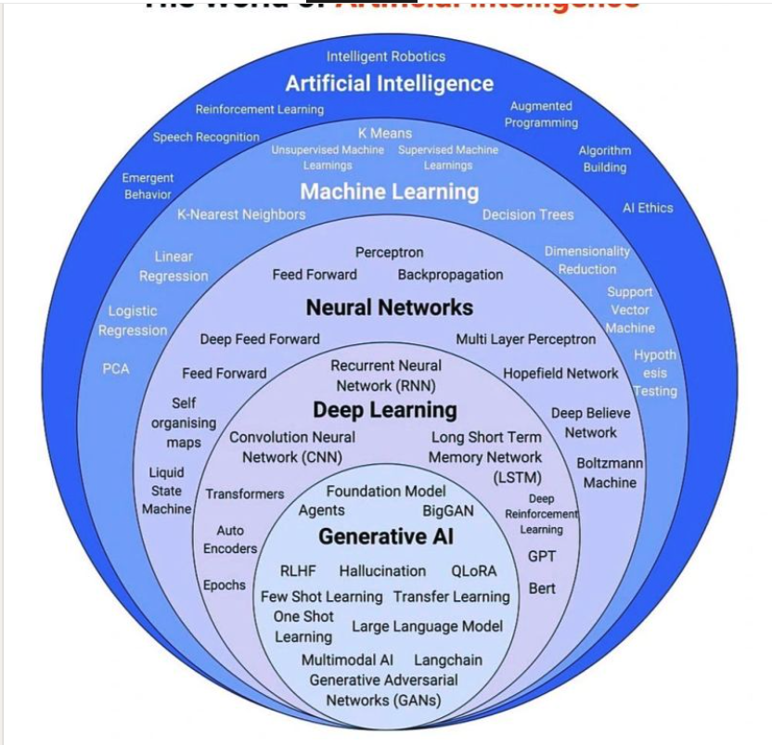
Venn Diagram of AI. ML and GenAI

Slide 3
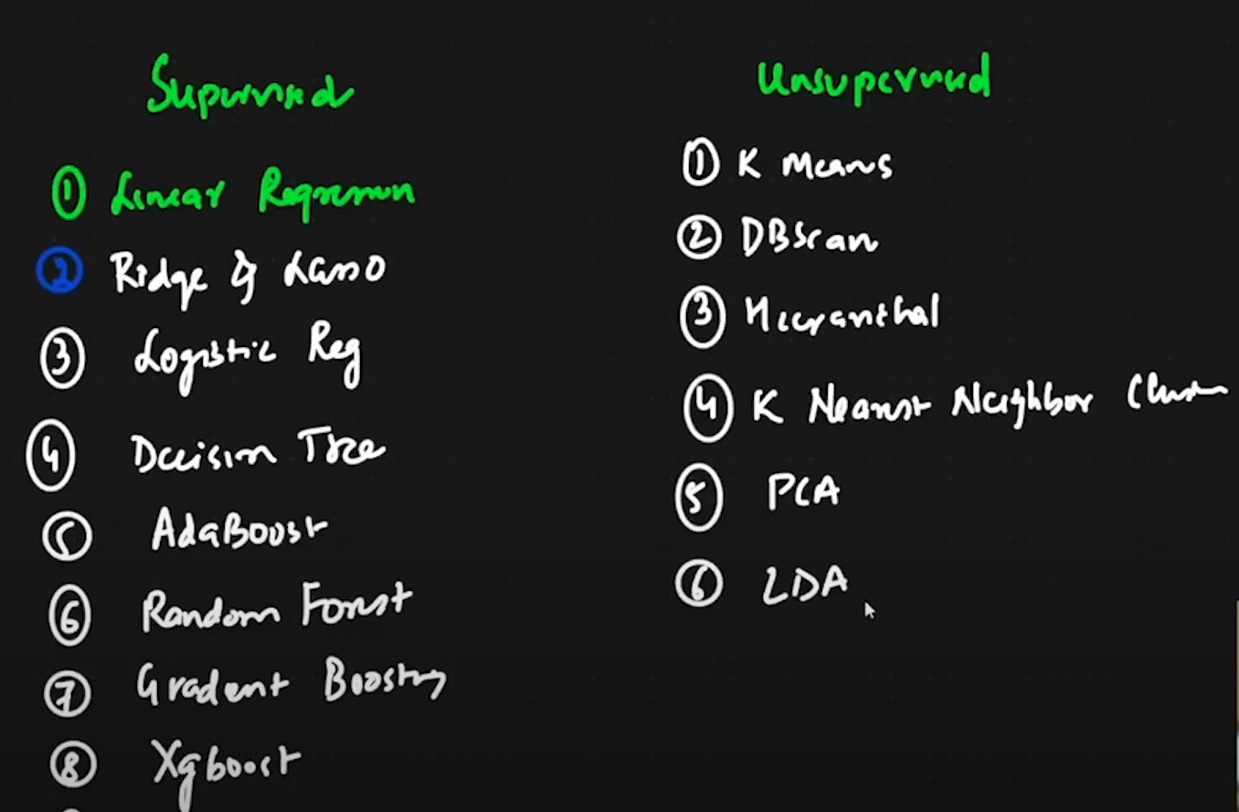
Types of Machine Learning Algorithm

Slide 5
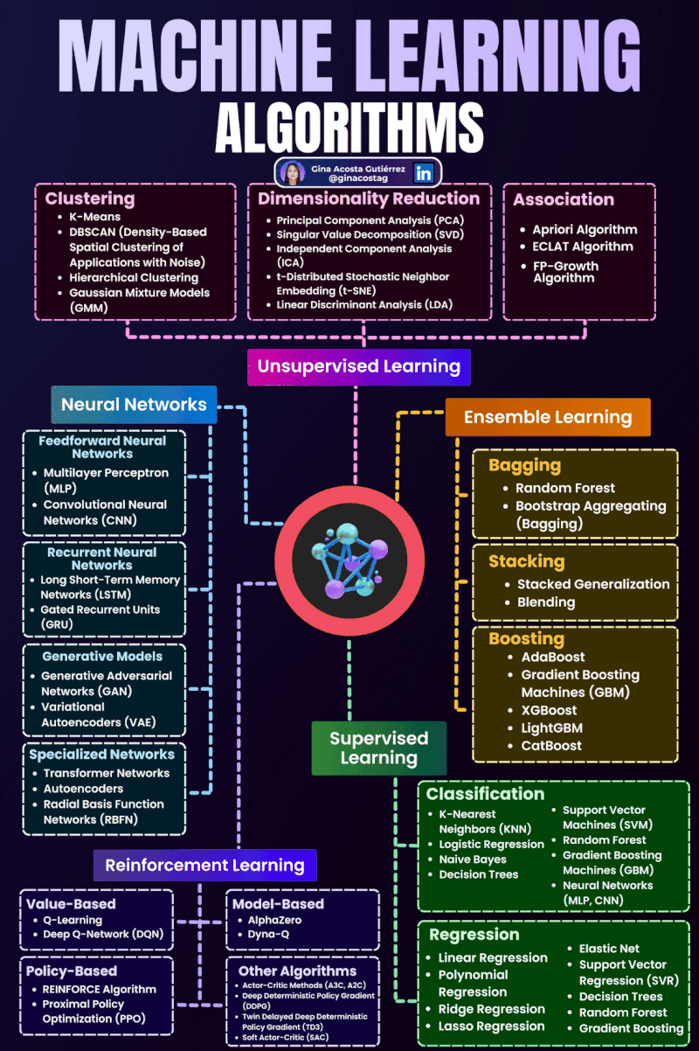

Slide 6
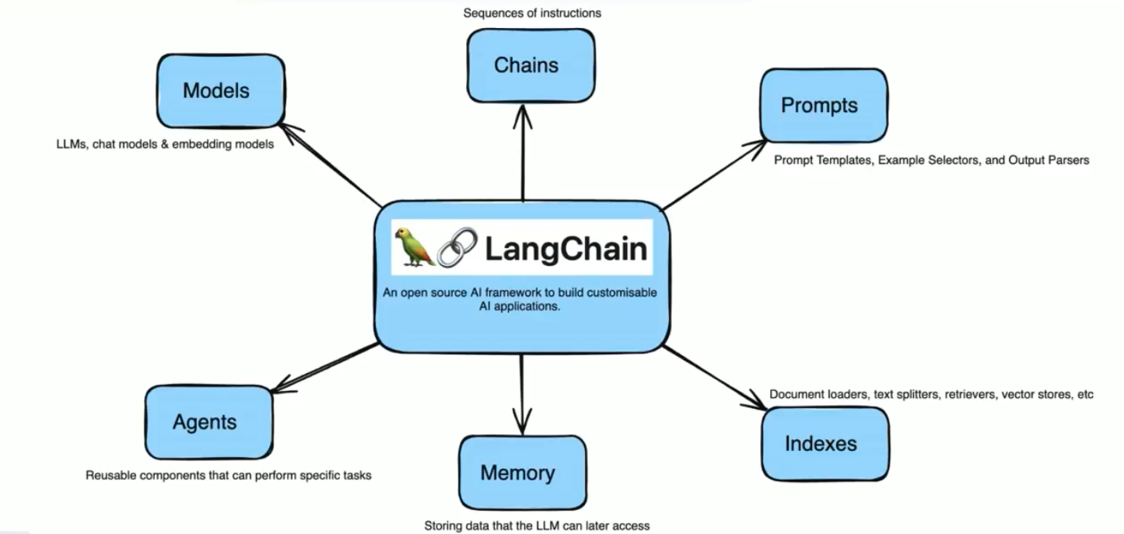
Langchain Interaction

Slide 7
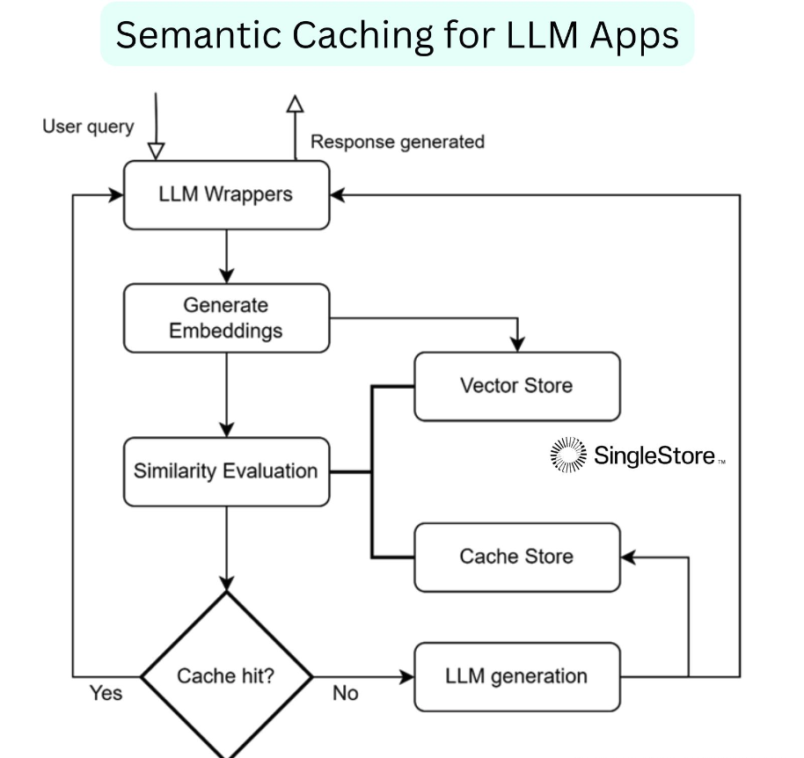

Slide 8


Slide 9
